Slide 1


Mahad Farooq
07-09-2021

Slide 2

Outline
Executive Summary
Introduction
Methodology
Results
Conclusion
Appendix

Slide 3
Executive Summary
Data was collected using the spacex API, and using the Wikipedia HTML tables using the beautifulsoup object
Data was preprocessed and cleaned for it to be fed to the predictive models
Predictive models yield a high accuracy result of around 83% accuracy to predict if the launch will be successful.

Slide 4
Introduction
SpaceX advertises Falcon 9 rocket launches on its website with a cost of 62 million dollars; other providers cost upward of 165 million dollars each, much of the savings is because SpaceX can reuse the first stage. Therefore if we can determine if the first stage will land, we can determine the cost of a launch. This information can be used if an alternate company wants to bid against SpaceX for a rocket launch.
we will predict if the Falcon 9 first stage will land successfully

Slide 5


Slide 6
Methodology
Executive Summary
Data collection methodology:
Request to SpaceX API to get data in json format, Falcon 9 launch data was extracted from Wikipedia (HTML tables) and converted to dataframe using Beautifulsoup
Perform data wrangling
Exploratory data analysis was done and training labels were determined, a classification variable representing the outcome was included in dataframe
Perform exploratory data analysis (EDA) using visualization and SQL
Perform interactive visual analytics using Folium and Plotly Dash
Perform predictive analysis using classification models

Slide 7
Data Collection
Datasets were collected using spaceX API
response = requests.get(spacex_url)
data = pd.json_normalize(response.json())
Helper functions were used to get important columns for the dataframe e.g getBoosterVersion(data), getLaunchSite(data)

Slide 8
Data Collection – SpaceX API
https://github.com/Mahadfarooq10/Coursera_DataScience_capstone/blob/master/Data%20Collection.ipynb
Response.get() : get page response in json
Json_normalize(response.get()
Use API for data ragarding launches

Slide 9
Data Collection - Scraping
https://github.com/Mahadfarooq10/Coursera_DataScience_capstone/blob/master/Web%20Scraping.ipynb
Wikipedia : List of Falcon 9 and Falcon heavy launches
Scraping agent : BeautifulSoup
Dataframe from parsing HTML tables

Slide 10
Data Wrangling
Datatypes were checked for each column using dtypes
Number of launches for each site were checked which showed CCAFS SLC 40 had 55(most) and VAFB SLC 4E had 13(least) launches
A classification variable ‘class’ was included in the dataframe which represented the outcome of launch. Zero : failure, One : Success
Success rate of all the launches was 66.66% found via mean
https://github.com/Mahadfarooq10/Coursera_DataScience_capstone/blob/master/Data%20Wrangling%20.ipynb

Slide 11
EDA with Data Visualization
FlightNumber vs. PayloadMass : different launch sites have different success rates. CCAFS LC-40, has a success rate of 60 %, while KSC LC-39A and VAFB SLC 4E has a success rate of 77%.
FlightNumber vs LaunchSite : Higher flight numbers tend to be more successful for all launch sites
PayloadMass vs LaunchSite : No solid inference
Bar chart to visualize the success rate of each orbit type which showed ES-L1, GEO, HEO, and SSO were most successful

Slide 12
EDA with Data Visualization
Flight Number vs Orbit type : LEO orbit the Success appears related to the number of flights; on the other hand, there seems to be no relationship between flight number when in GTO orbit.
Payload Vs Orbit type : Heavy payloads have a negative influence on GTO orbits and positive on GTO and Polar LEO (ISS) orbits.
Launch Success yearly trend shows that success rate has been increasing since 2013 onwards
https://github.com/Mahadfarooq10/Coursera_DataScience_capstone/blob/master/Analysis%20using%20Visualization.ipynb

Slide 13
EDA with SQL
All unique launch sites were found, results showed 4 unique launch sites
Total mass carried by the boosters carried by NASA CRS : 45596 kgs
Average Mass carried by booster version F9 v1.1 : 2928 kgs
Date of first successful landing outcome: 2015-12-22
99 successful mission outcomes, 1 flight failure and 1 successful but status unclear
https://github.com/Mahadfarooq10/Coursera_DataScience_capstone/blob/master/Data%20Analysis%20with%20SQL.ipynb

Slide 14
Build an Interactive Map with Folium
Launch sites were marked on the map
The successful and failed launches were marked using the marker_cluster object
Distance between launch site and its nearest railway was also marked using PolyLine
https://github.com/Mahadfarooq10/Coursera_DataScience_capstone/blob/master/Visual%20Analytics%20with%20Folium.ipynb

Slide 15
Build a Dashboard with Plotly Dash
Pie charts for success rate of each/all launch site created and also a scatter plot of payload mass vs class using variable payload mass range via slider
Most successful launch site can be found after visualizing the pie charts
The effect of payload mass on the success rate can also be determined using the scatter plot
https://github.com/Mahadfarooq10/Coursera_DataScience_capstone/blob/master/spacex_dash_app.py

Slide 16
Predictive Analysis (Classification)
Standardized data using preprocessing.standardscaler(), data was split in train and test sets using 80/20 ratio
Logistic regression, support vector machine, decision tree and KNN were trained using the best parameters
Best parameters were found using GridSearchCv.fit()
https://github.com/Mahadfarooq10/Coursera_DataScience_capstone/blob/master/Machine%20Learning%20Prediction.ipynb

Slide 17
Results
Exploratory data analysis results
Interactive analytics demo in screenshots
Predictive analysis results

Slide 18


Slide 19
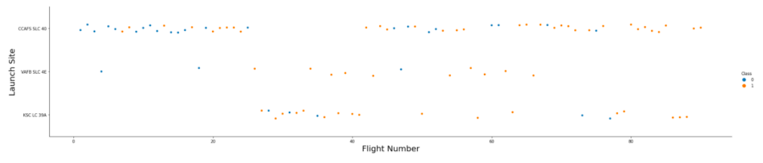
Flight Number vs. Launch Site
Higher flight numbers reported more successful landings

Slide 20
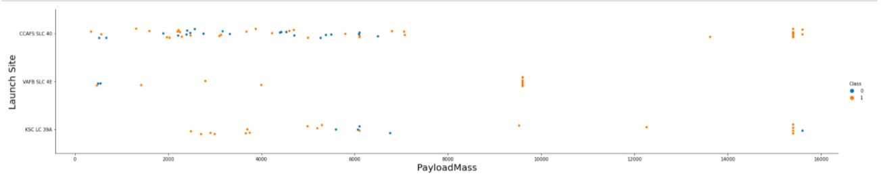
Payload vs. Launch Site
CCAFS SLC 40 and VAFB SLC 4E low Payload mass relatively high failures
KSC LC 39A had most failures in 5000-7000 Kg range

Slide 21
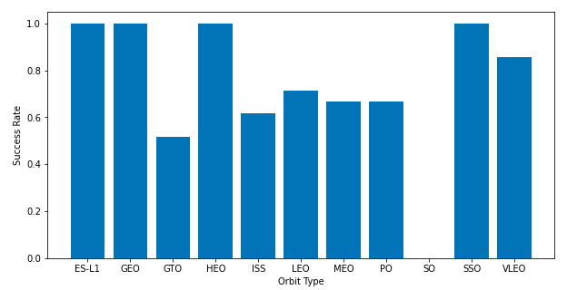
Success Rate vs. Orbit Type
visualizing the success rate of each orbit type shows ES-L1, GEO, HEO, and SSO were most successful.
SO had 0 success rate

Slide 22
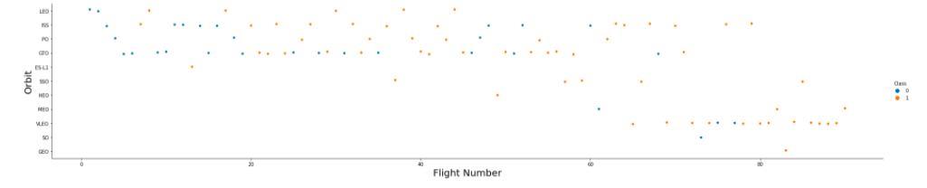
Flight Number vs. Orbit Type
LEO orbit the Success appears related to the number of flights; on the other hand, there seems to be no relationship between flight number when in GTO orbit.

Slide 23
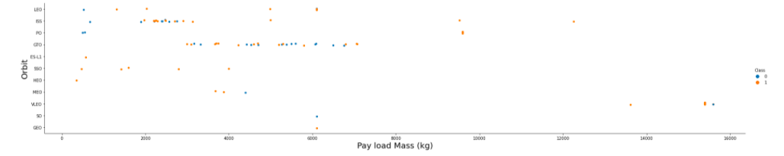
Payload vs. Orbit Type
Heavy payloads have a negative influence on GTO orbits and positive on GTO and Polar LEO (ISS) orbits

Slide 24
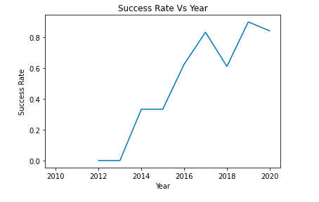
Launch Success Yearly Trend
the success rate since 2013 kept increasing till 2020

Slide 25
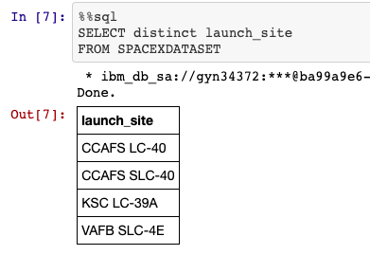
All Launch Site Names
4 different Launch sites

Slide 26
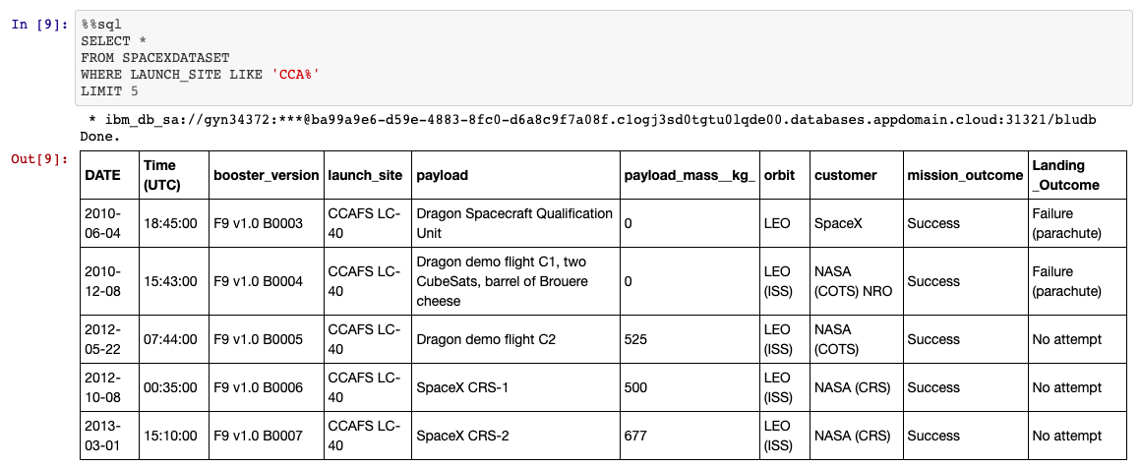
Launch Site Names Begin with 'CCA'

Slide 27
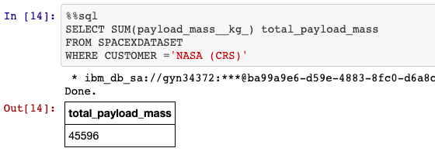
Total Payload Mass

Slide 28
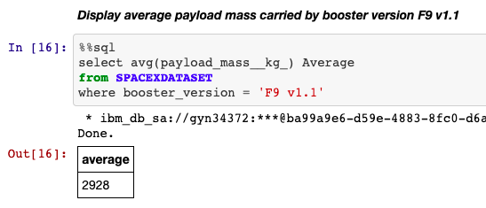
Average Payload Mass by F9 v1.1

Slide 29
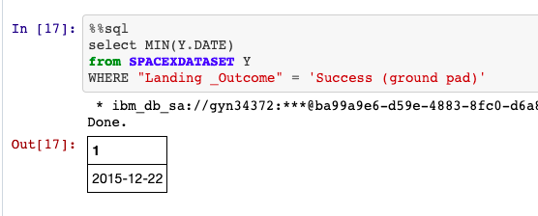
First Successful Ground Landing Date

Slide 30
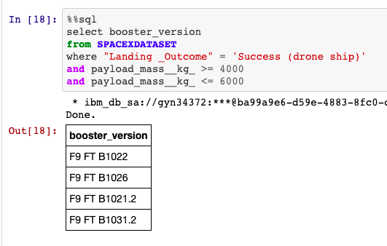
Successful Drone Ship Landing with Payload between 4000 and 6000

Slide 31
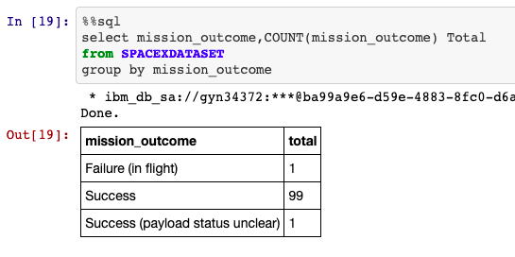
Total Number of Successful and Failure Mission Outcomes

Slide 32
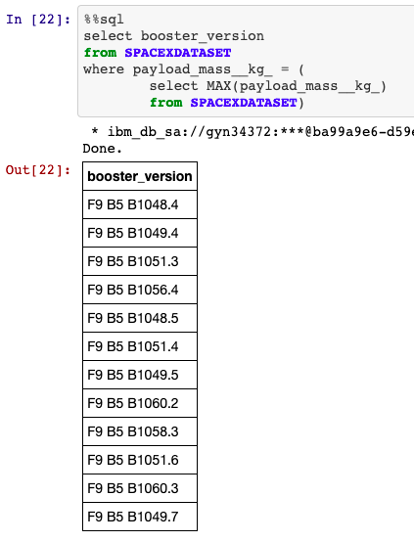
Boosters Carried Maximum Payload

Slide 33
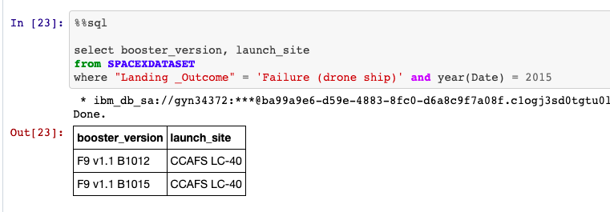
2015 Launch Records

Slide 34
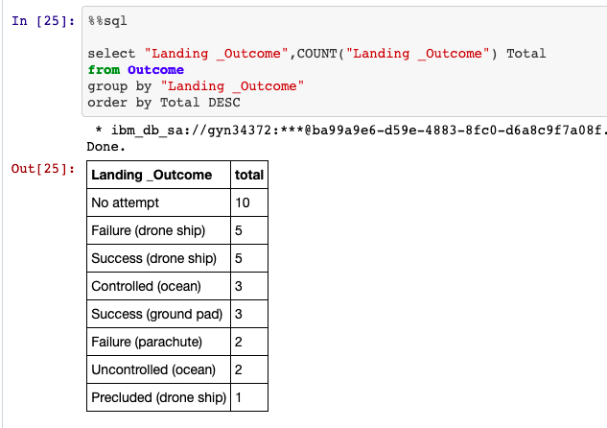
Rank Landing Outcomes Between 2010-06-04 and 2017-03-20

Slide 35


Slide 36
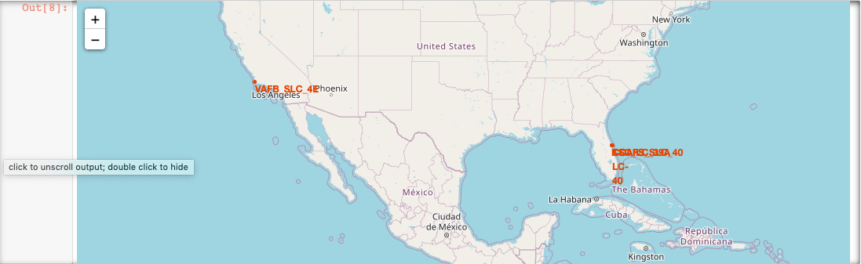
Location of all launch sites

Slide 37
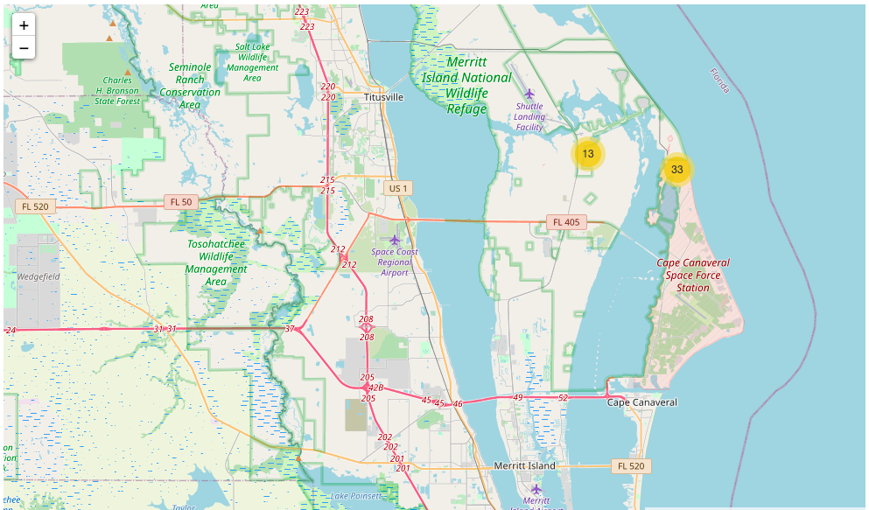
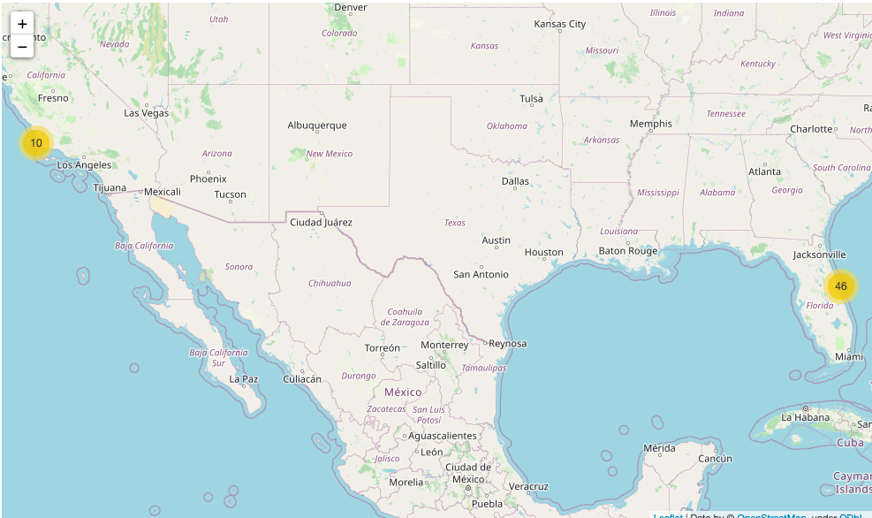
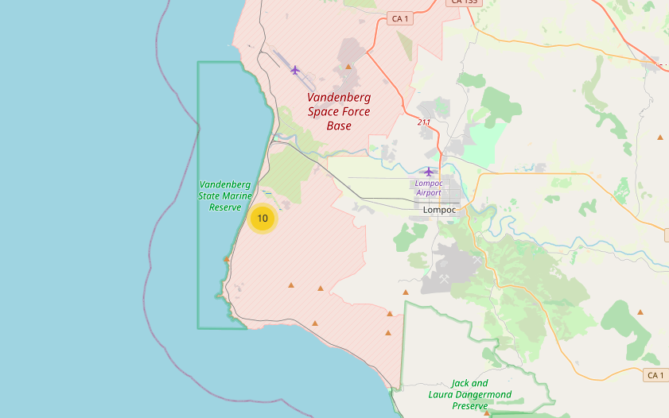
Number of launches per launch site

Slide 38
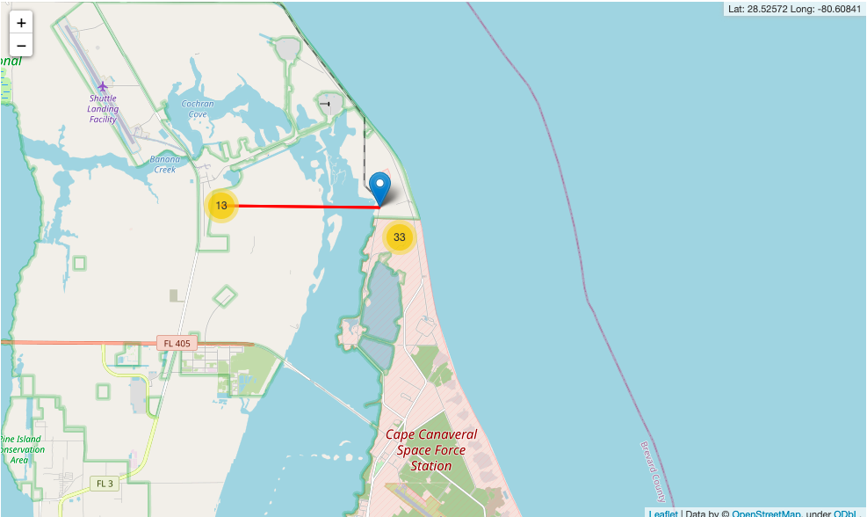
Closest railway station

Slide 39


Slide 40
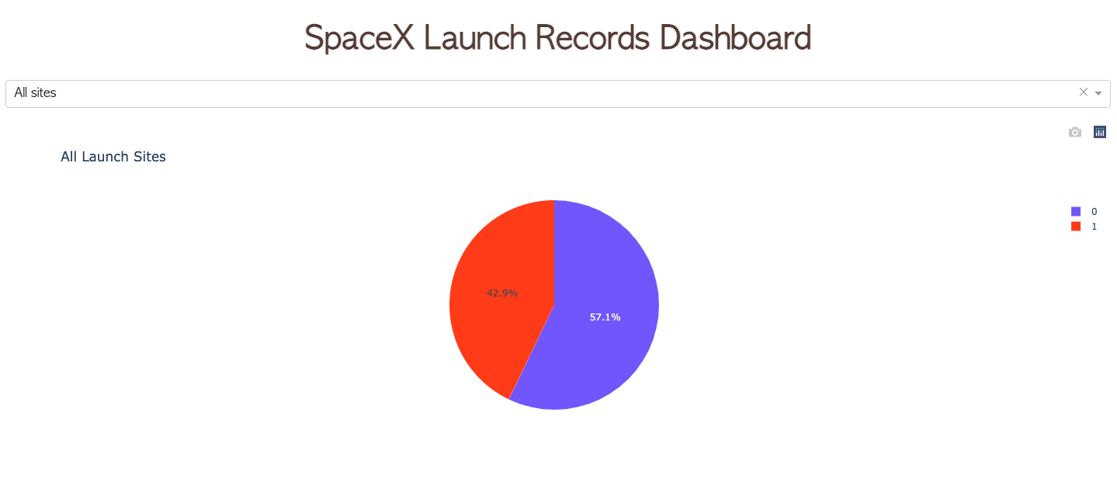
Success rate of all launch sites
A 42.9% success rate for combined launch sites

Slide 41
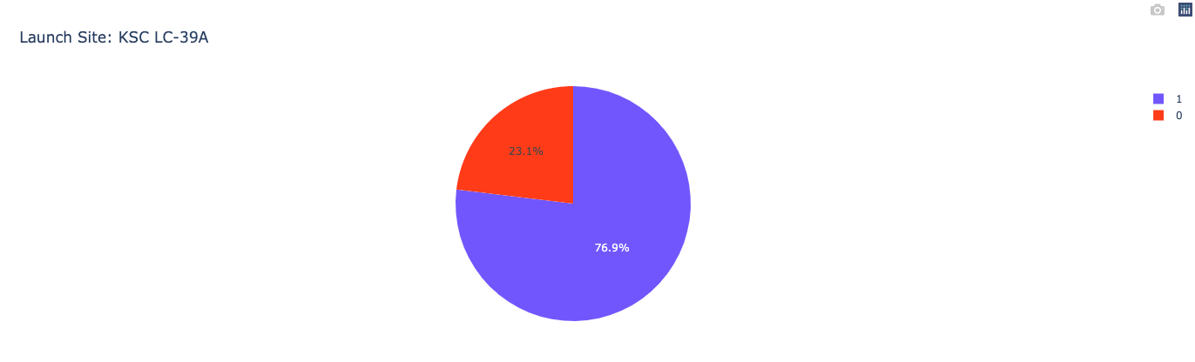
Most successful launch site : KSC LC-39A

Slide 42
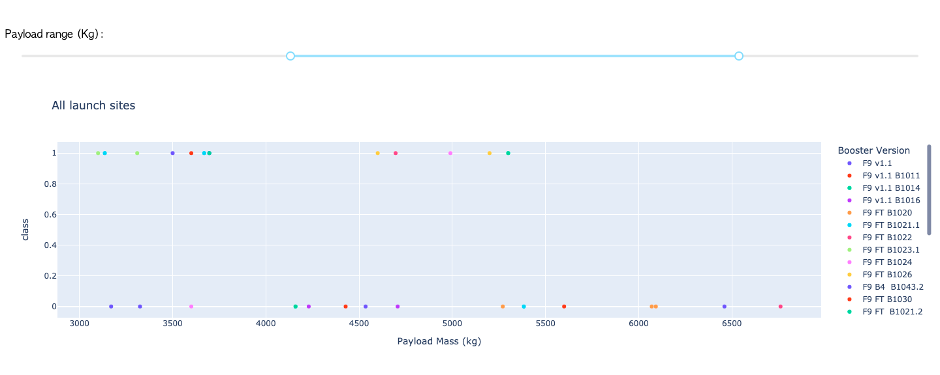
Payload vs Launch outcome

Slide 43


Slide 44
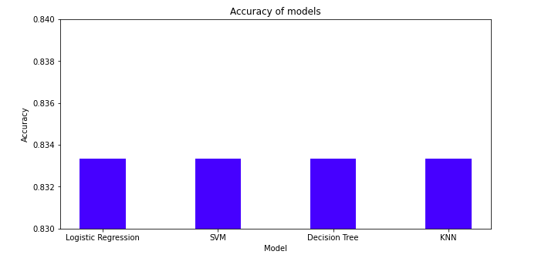
Classification Accuracy
Test set accuracy of models is similar.
While the decision tree has the best train set accuracy of 0.876 being the highest.

Slide 45
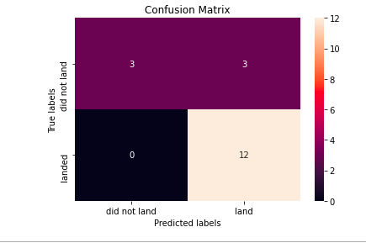
Confusion Matrix
Accuracy : 0.83
Precision : 0.80
Recall : 1.0
F1 Score : 0.88

Slide 46
Conclusions
All models give good results with an accuracy of 0.83 on test test.
False positives are reported for all models.
No false negatives.
We can predict with a good amount of accuracy if the launch will be successful or not and if it is feasible to bid for the launch.

Slide 47
Appendix
Libraries used
import pandas as pd
import numpy as np
import matplotlib.pyplot as plt
import seaborn as sns
import requests
import folium
import wget
from bs4
import BeautifulSoup
Import re
Import unicodedata

Slide 48


